Slide 1

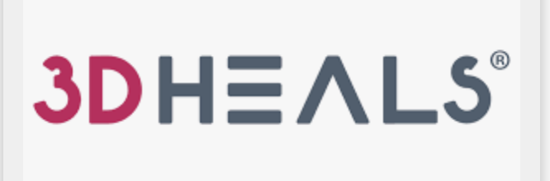
ALY 6080 : FINAL
PRESENTATION
r
By - Bhagyashri K , Qihuan He , Xiaoge Zhang & Yuchen Zhao
29th June 2023
Professor - Venkata Duvvuri

Slide 2
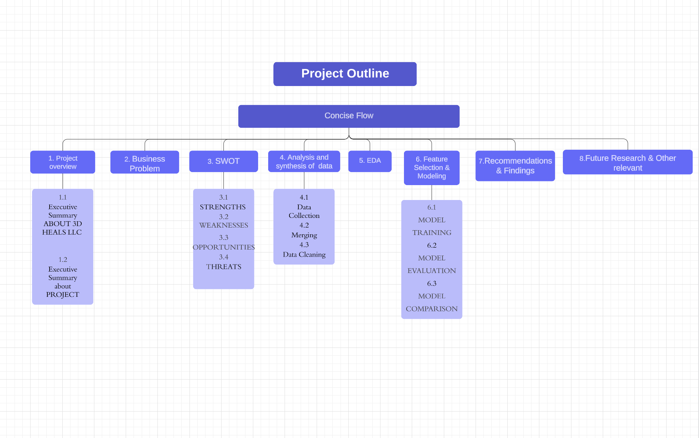

Slide 3
Executive Summary: ABOUT 3D HEALS LLC
3D Heals is a company that focuses on providing education and resources related to 3D printing in healthcare.
They aim to bring together professionals from various industries, such as medical, dental, and engineering, to share knowledge and collaborate on the advancement of 3D printing technology in healthcare.
Their services include consulting, event planning, and publishing. The company also offers a comprehensive database of 3D printing technologies and services in healthcare, as well as an online community for professionals to connect and share information.

Slide 4
Executive Summary: PROJECT
Predicting channel of preference of communication for an existing user ( email , social media , web etc. )
Understanding the channel preferences of individual users is crucial for effective communication and personalized customer experiences. This project aims to develop a predictive model that determines the channel of preference for an existing user, whether it's email, social media, web-based platforms, or other communication channels.

Slide 5
Business Problem
How have audience interests in different 3D printing topics changed across different seasons?
How does event attendance vary across different countries?
Which communication channels (MailChimp, LinkedIn, website, etc.) are most effective for driving event attendance?
What is the attendance rate for our events and how has it changed over time?
What proportion of people who register for events actually attend them, and how does this vary over time?
How does attendance vary among different fields within the 3D printing industry?
Which industries have the highest number of attendees at our events?
How long do attendees typically stay at our events?
Which factors (such as job title, professional background, location, etc.) are most influential in determining the most effective marketing channel for an individual?
Which predictive model will provide the most accurate selection of marketing channels given our dataset?

Slide 6
SWOT ANALYSIS
STRENGTHS WEAKNESSES
Strong brand recognition Limited resources
Expertise in 3D printing and healthcare Dependence on partnerships
Extensive network Limited geographic reach
Strong online presence
OPPORTUNITIES THREATS
Growing demand for 3D printing in healthcare Competition
Expansion into new markets Regulatory challenges
Development of new products Economic downturns

Slide 7
STRENGTHS
Strong brand recognition: 3D Heals has established itself as a leader in the 3D printing and healthcare industry and has a reputation for providing high-quality services and products.
Expertise in 3D printing and healthcare: 3D Heals has a team of experts with diverse backgrounds in 3D printing and healthcare, which allows them to provide innovative and unique solutions.
Extensive network: 3D Heals has a broad network of industry partners and collaborators, which enables them to stay up-to-date on the latest trends and technologies in the field.
Strong online presence: 3D Heals has a well-designed website, social media presence, and blog, which helps them to reach a wider audience and promote their services and products.

Slide 8
WEAKNESS
Limited resources: 3D Heals is a small company with limited resources, which can make it difficult to compete with larger companies in the industry.
Dependence on partnerships: 3D Heals relies heavily on partnerships and collaborations, which can create vulnerability if those relationships are disrupted.
Limited geographic reach: Although 3D Heals has a broad network, they are primarily focused on the United States and may miss out on opportunities in other parts of the world.

Slide 9
OPPORTUNITIES
Growing demand for 3D printing in healthcare: The demand for 3D printing in healthcare is increasing as the technology becomes more advanced, which presents a significant growth opportunity for 3D Heals.
Expansion into new markets: 3D Heals can expand their services and products to new markets, such as veterinary medicine and dentistry.
Development of new products: 3D Heals can leverage their expertise in 3D printing and healthcare to develop new and innovative products that meet the needs of their clients.

Slide 10
THREATS
Competition: There is a growing number of companies entering the 3D printing and healthcare industry, which increases competition for 3D Heals.
Regulatory challenges: The regulatory landscape for 3D printing in healthcare is complex and constantly evolving, which can create challenges for 3D Heals.
Economic downturns: Economic downturns can lead to reduced demand for 3D printing and healthcare services and products, which can impact 3D Heals' revenue and growth.

Slide 11
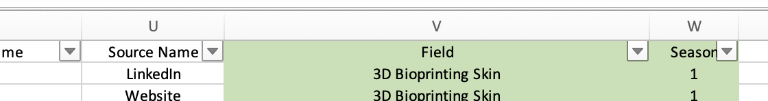
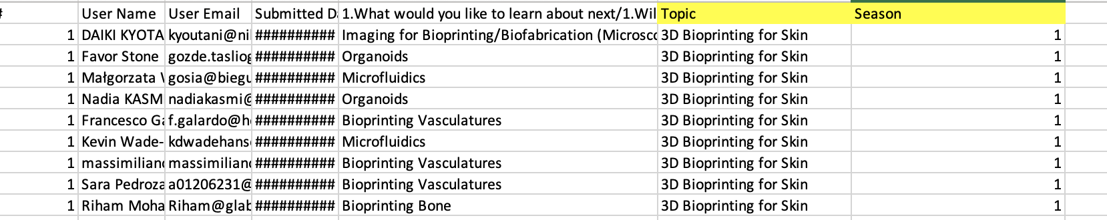
ANALYSIS & SYNTHESIS OF DATA DATA COLLECTION & MERGING
The first step in our data preparation process was to consolidate all the attendance sheets from season 1 to season 4 and all the industry data into one place.
Next, we created two new variables, SEASON and FIELD, to help us better understand the relationships between attendance and field over time.
We also applied the same approach to the Total_Poll report.

Slide 12
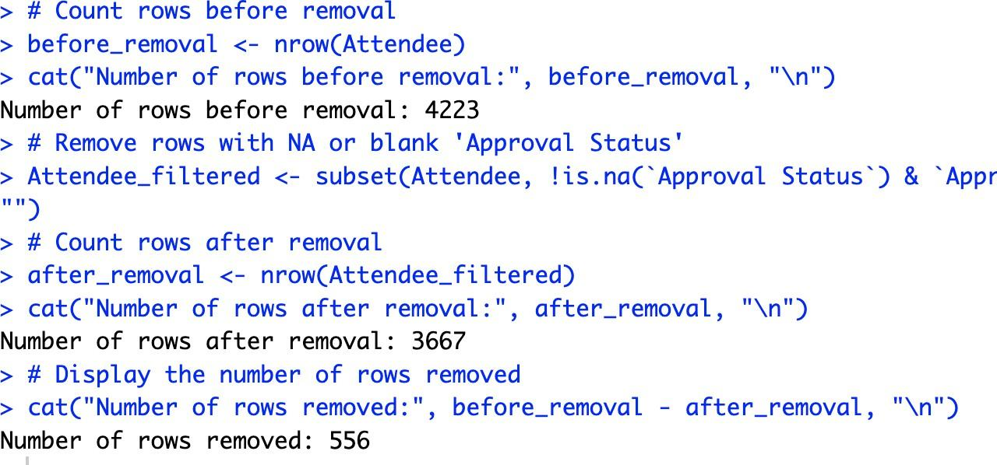
DATA PRE-PROCESSING
We cleaned the dataset by removing duplicates. Some people had over-registered for the form, resulting in duplicate entries.
We also checked for any missing values or data entry errors and corrected them as necessary.
Total 556 records were removed.

Slide 13
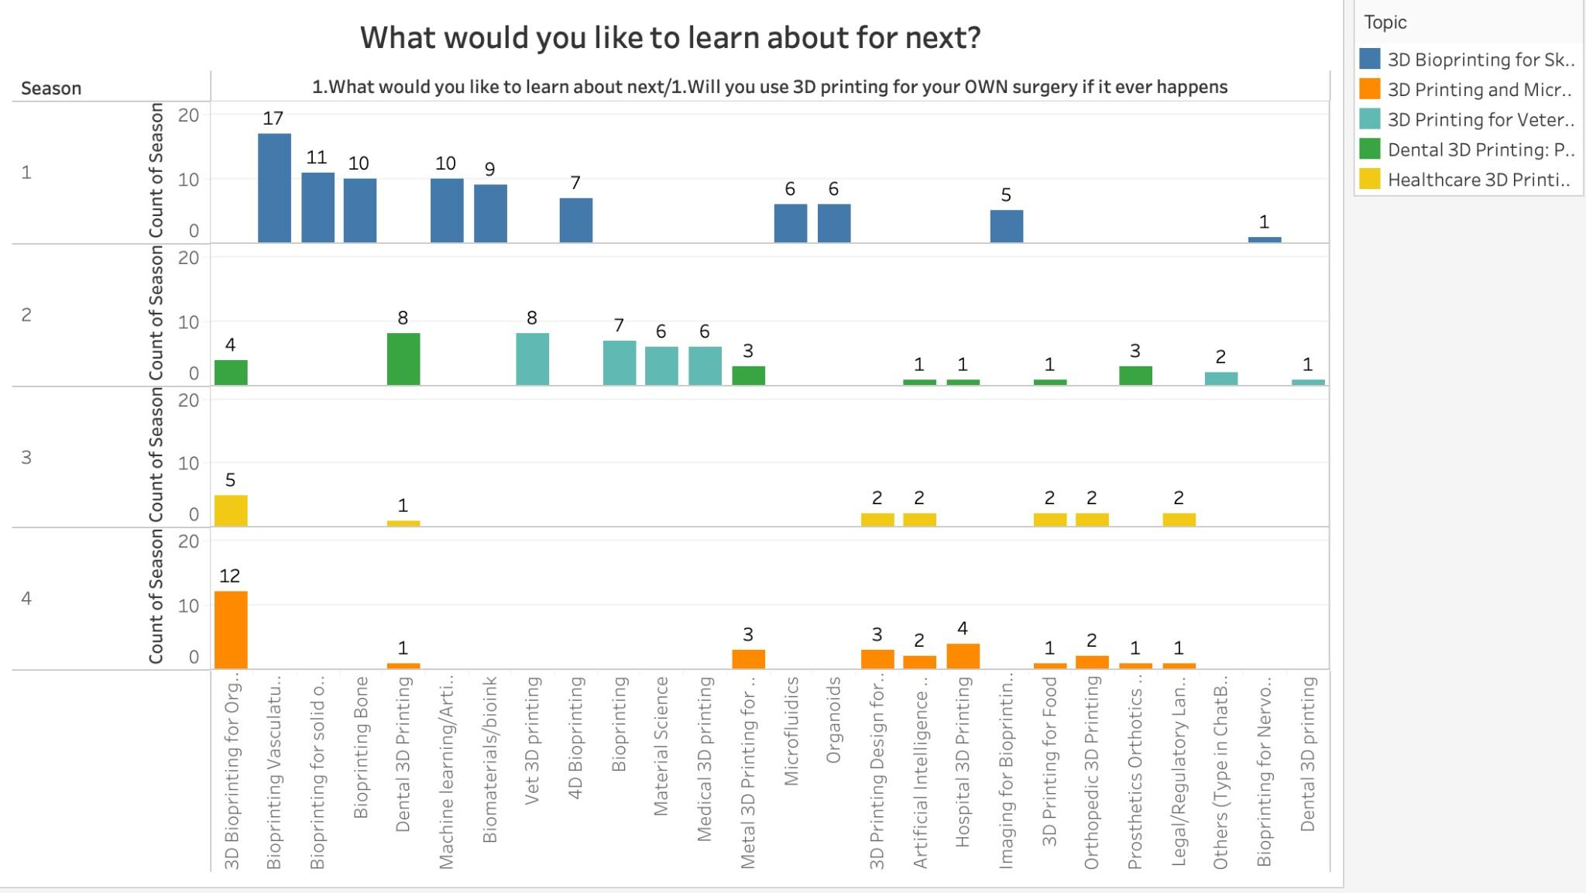
EXPLORATORY DATA ANALYSIS
TOTAL POLL REPORT
Season 1: Highest - 3D Bioprinting for Organs, illustrating a strong interest in this subject; Lowest - Dental 3D Printing, indicating less enthusiasm for this area during this period.
Season 2: Highest - Dental 3D Printing and Vet 3D Printing, showcasing a shift in customer preferences and increased demand for these subjects; Lowest - Artificial Intelligence for 3D Printing, reflecting diminished interest in this topic during Season 2.
Season 3: Highest - 3D Bioprinting for Organs, underlining the ongoing evolution of customer interests; Lowest - Dental 3D Printing, suggesting that customers found this subject less relevant or engaging during that season.
Season 4: Highest - 3D Bioprinting for Organs, emphasizing continued changes in customer preferences and a strong desire to learn about this topic; Lowest - Dental 3D Printing, revealing less inclination to explore this area during Season 4.

Slide 14
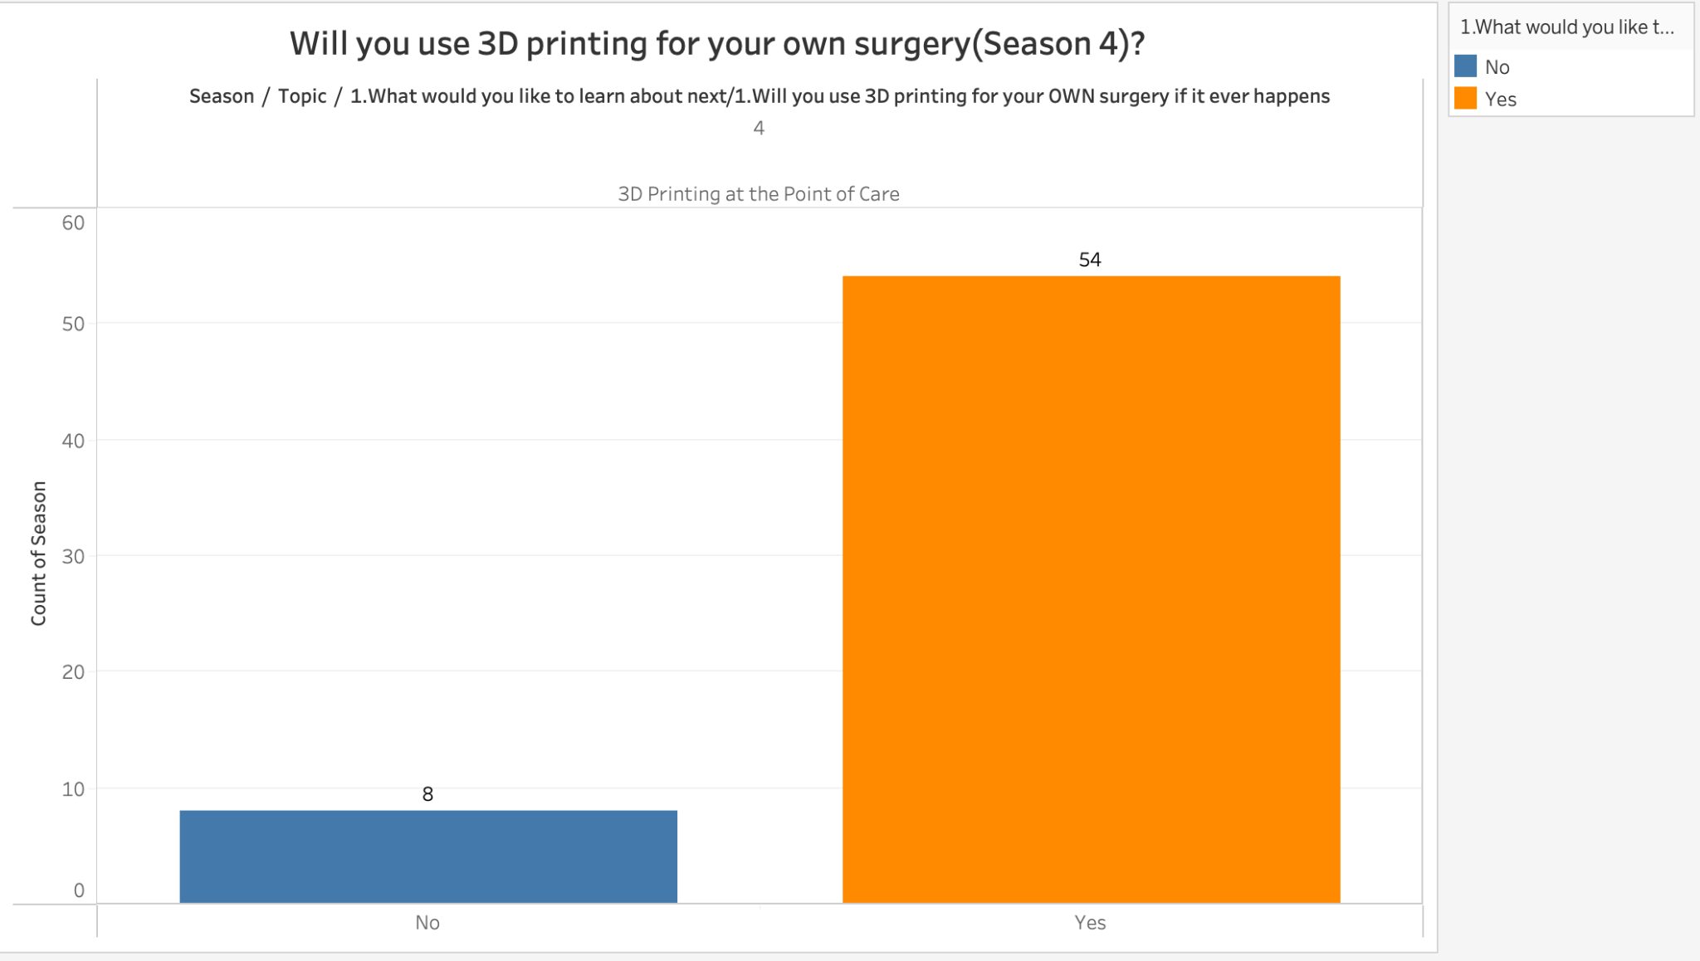
EXPLORATORY DATA ANALYSIS
TOTAL POLL REPORT
The graph displays the results of a survey question related to the use of 3D printing for personal surgery in the future. Out of a total of 62 respondents, 54 indicated that they would use 3D printing for their own surgery, while the remaining 8 respondents said that they would not.

Slide 15
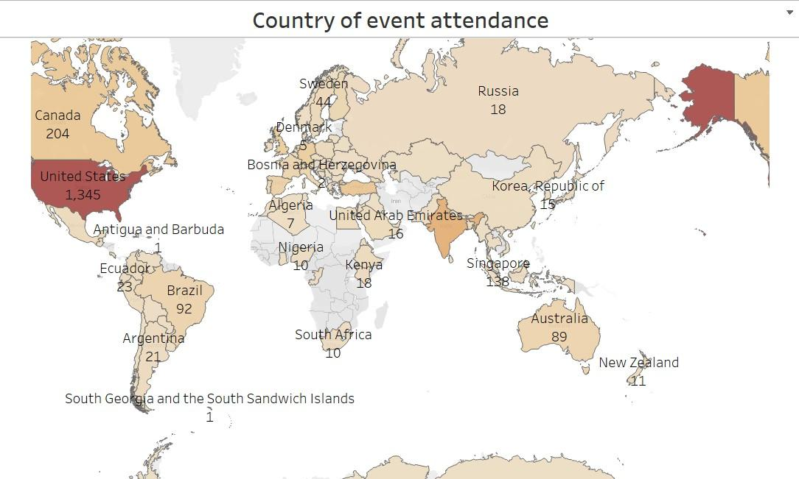
EXPLORATORY DATA ANALYSIS
ATTENDANCE DATASET
The United States has the most event attendance over other countries, followed by Canada.

Slide 16
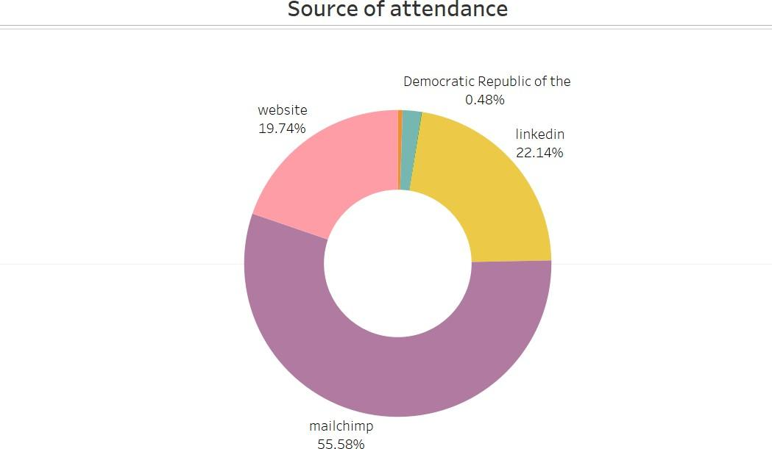
EXPLORATORY DATA ANALYSIS
Which communication channels (MailChimp, LinkedIn, website, etc.) are most effective for driving event attendance?
The majority of event attendance from MailChimp with 55.58% target audience,
followed by attendance from LinkedIn and website.

Slide 17
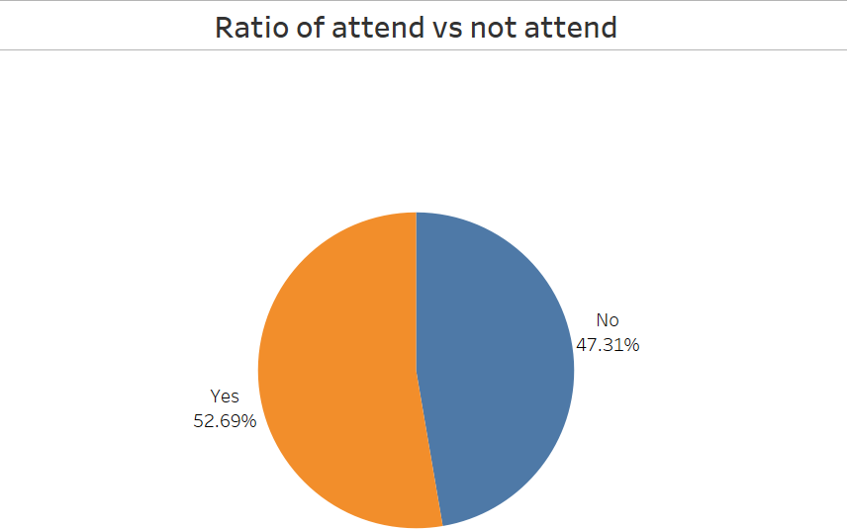
EXPLORATORY DATA ANALYSIS
What is the overall attendance rate for our events ?
The attendance rate of the event is 52.69%, we should conduct further research to find out the reason for the customers not attending the event and how to improve the attendance rate.

Slide 18
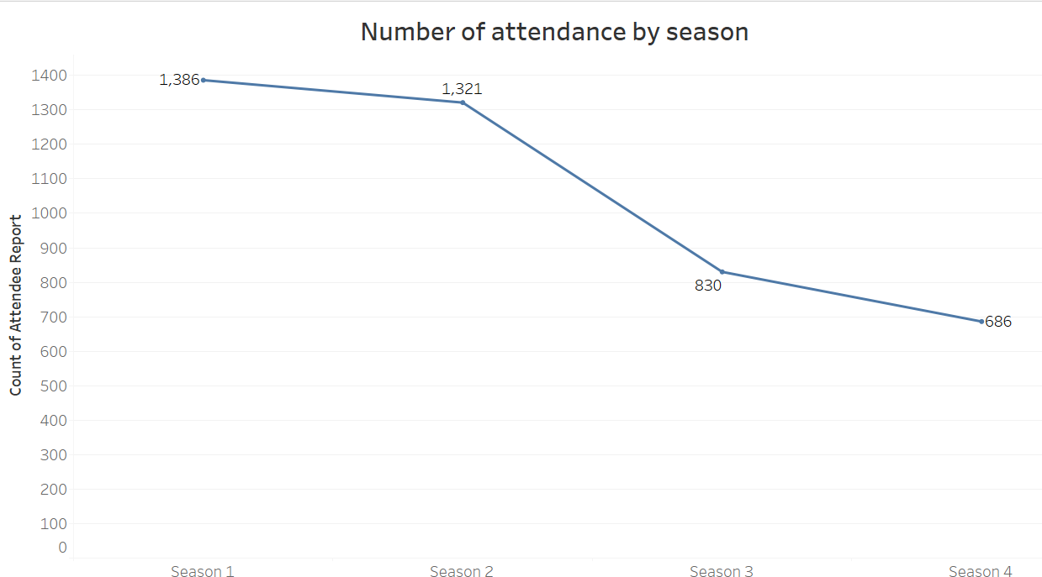
ATTENDANCE TIMELINE
How has attendance changes changed over time?
The overall number of attendances has a downward trend, season 1 has the largest number of attendance, almost more than 50% of the audience registered for events not shown in season 1

Slide 19
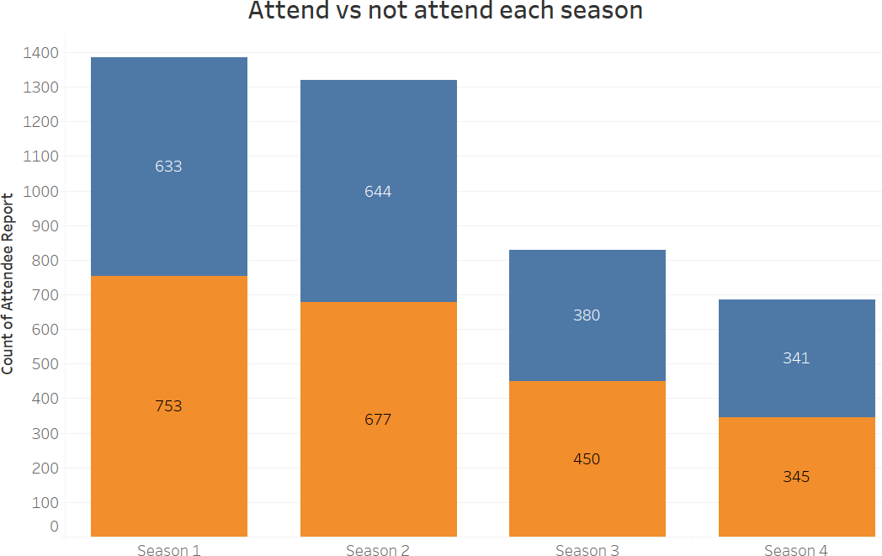
EXPLORATORY DATA ANALYSIS
Which Season had the highest Attendance ?
The combined bar graph shows that almost 50% of people registered for the event did not attend. The event organizer can further conduct research to identify the reason that customer registered but not attend the event.

Slide 20
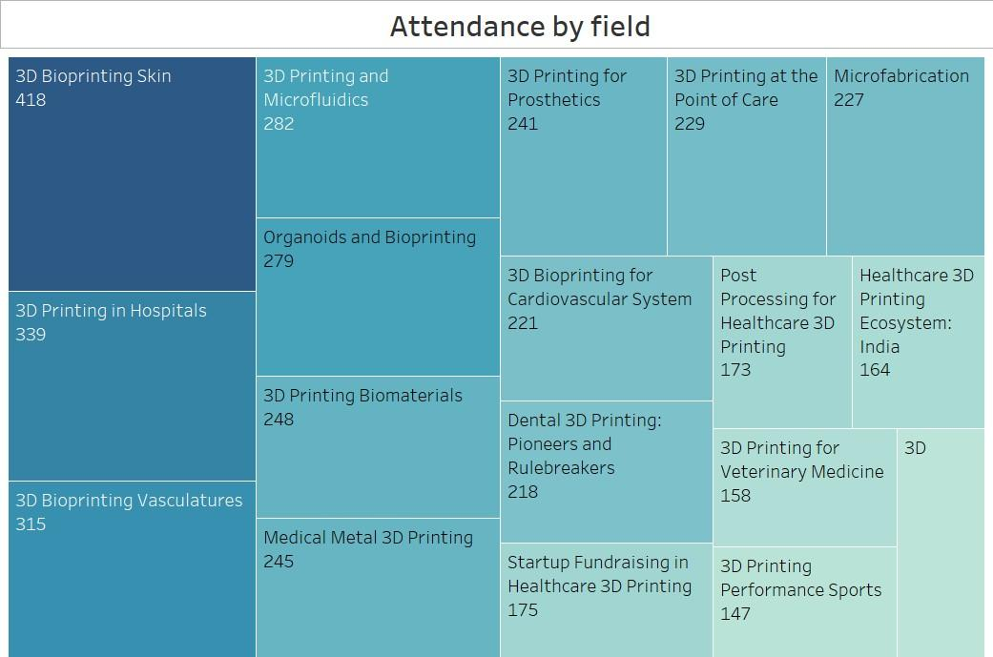
EXPLORATORY DATA ANALYSIS
Which field had the highest attendees ?
The above heatmap demonstrates the distribution of attendees by field. The 3D Bioprinting Skin industry has 418 attendees which is the largest number of attendees than other groups, and then is 3D printing Hospitals.

Slide 21
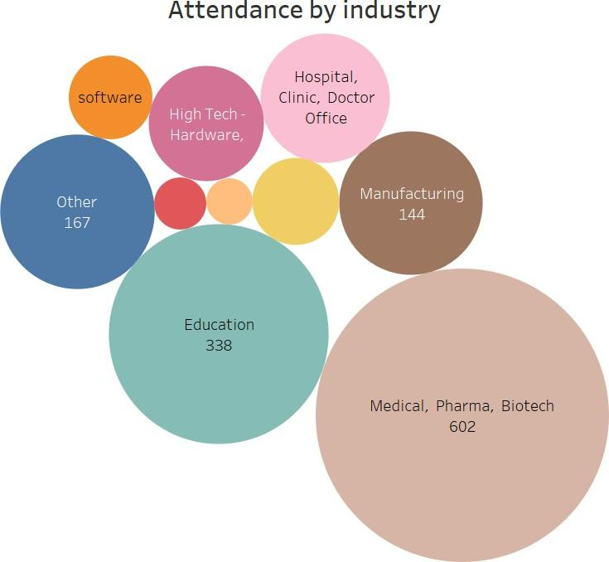
EXPLORATORY DATA ANALYSIS
Which Industry had the highest attendees ?
The medical, pharma and biotech industry has the largest number of attendees and is followed by the education industry.

Slide 22
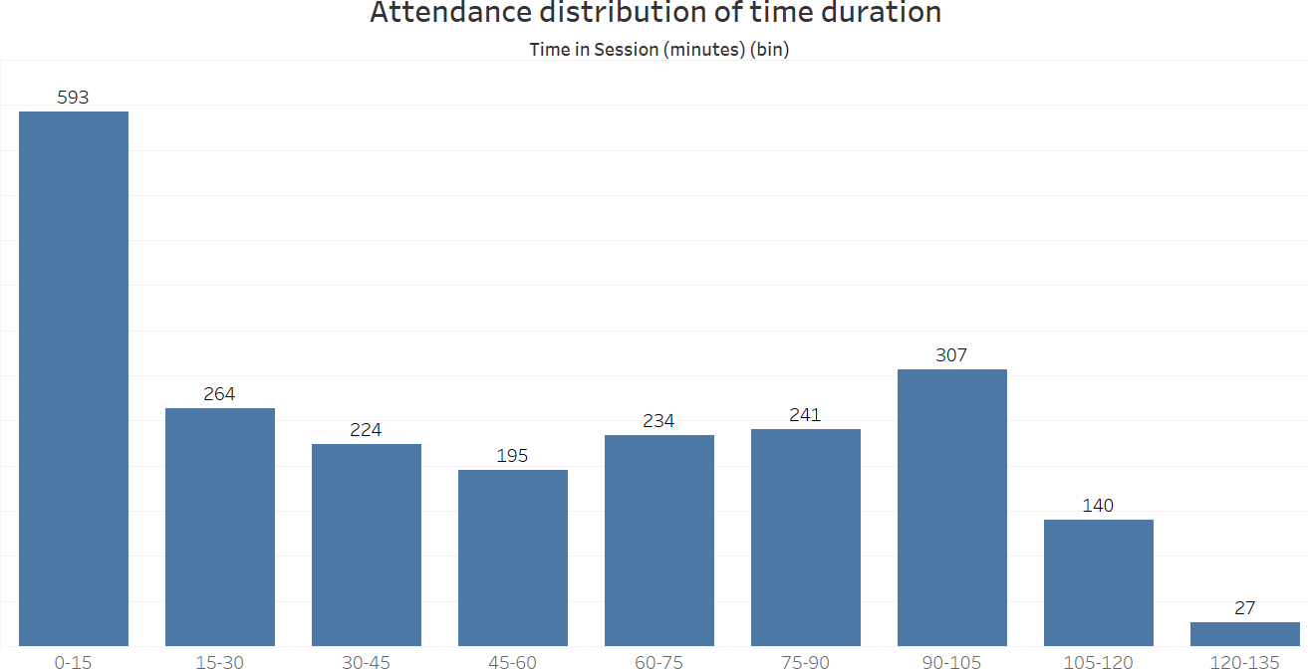
EXPLORATORY DATA ANALYSIS
Which Industry had the highest attendees ?
EXPLORATORY DATA ANALYSIS
What is the Attendance time duration distribution ?
Most of the event attendees stay in the event within 15 minutes, the event organizer or speaker can think about how to better interact with the target audience to extend the time duration of attendees on the event.

Slide 23
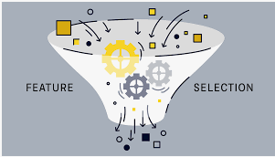

FEATURE SELECTION
&
MODELING

Slide 24
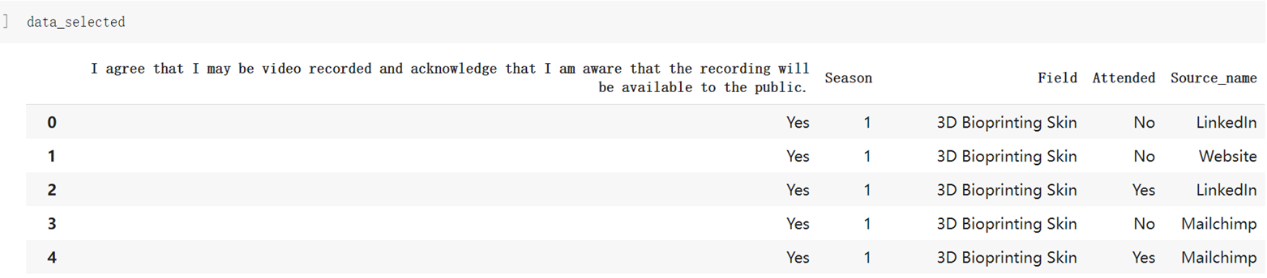
Besyt
Lasso Regularization Model for Feature Selection
Feature Selection:
Lasso regularization selected the above top 4 most significant features for predicting the Communication channel (Source) based on their respective coefficients obtained from our Lasso model.

Slide 25
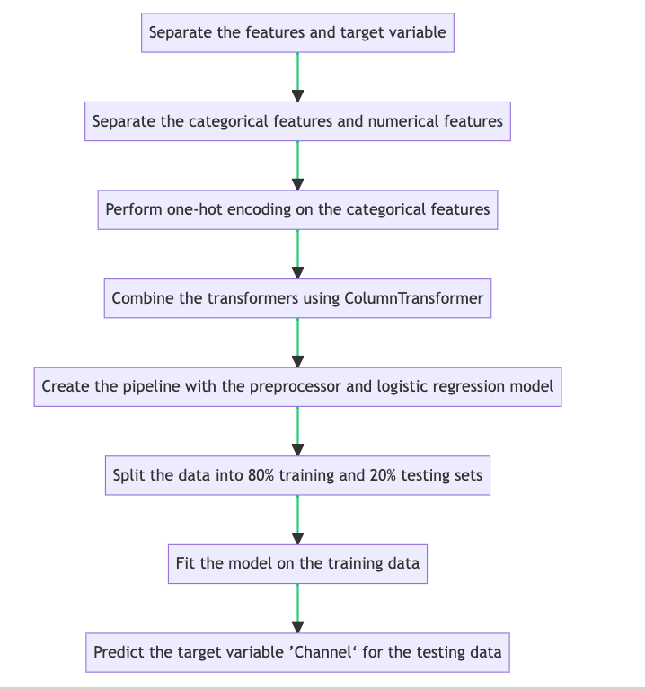
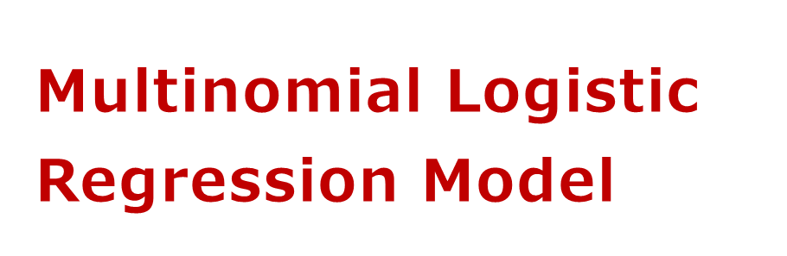
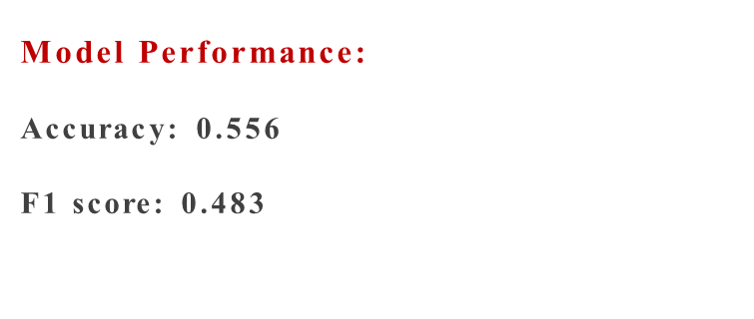
Multinomial Logistic Regression Model
Target Variable : Source Name
(Communication Channel)
Dependent Variables : Selected Features From Lasso Model
'I agree that I may be video recorded and acknowledge that I am aware that the recording will be available to the public.'
'Attended'
'Field’ &
‘Season’
Model Performance :
Accuracy : 56%
F1 score : 0.48

Slide 26
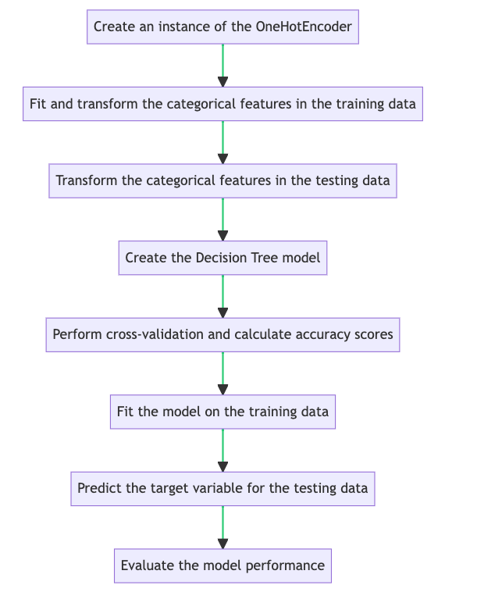
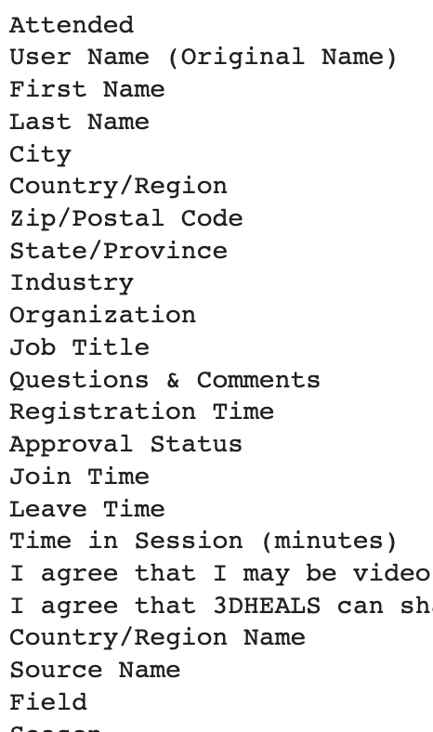
Decision Tree Model
Target Variable : Source Name
(Communication Channel)
Dependent Variables :
All features of the
combined dataset
Model Performance:Accuracy: 58% F1 Score: 0.55

Slide 27
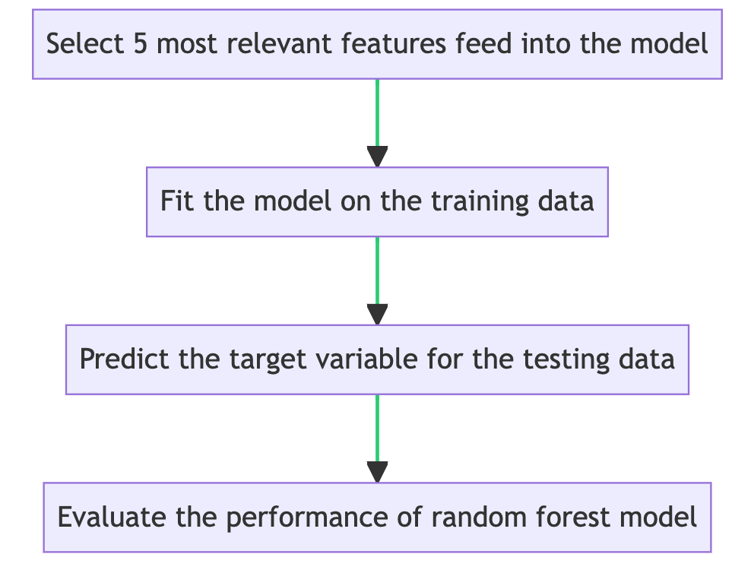
Random Forest Model - Selected Features
Target Variable : Source Name
(Communication Channel)
Dependent Variables : Selected Features From Lasso Model
'I agree that I may be video recorded and acknowledge that I am aware that the recording will be available to the public.'
'Attended'
'Field’ &
‘Season’
Model Performance:Accuracy: 55.6% F1 Score: 0.50

Slide 28
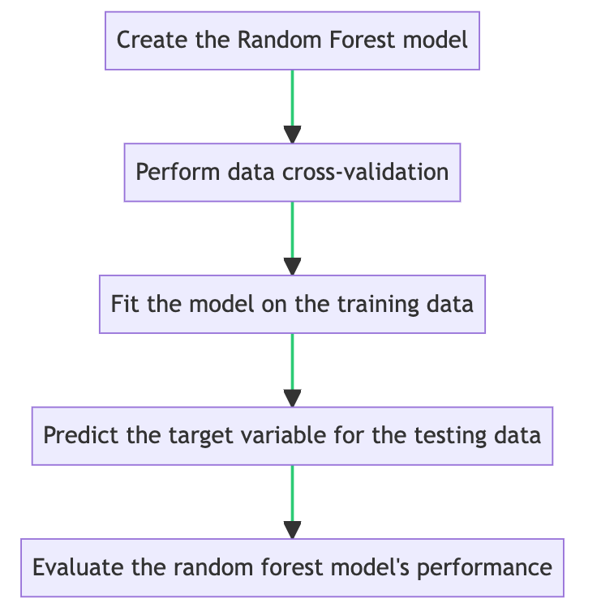
Random Forest Model - All Features
Target Variable : Source Name
(Communication Channel)
Dependent Variables : All features
of the combined dataset
Model Performance:
Accuracy: 61%
F1 Score: 0.53

Slide 29
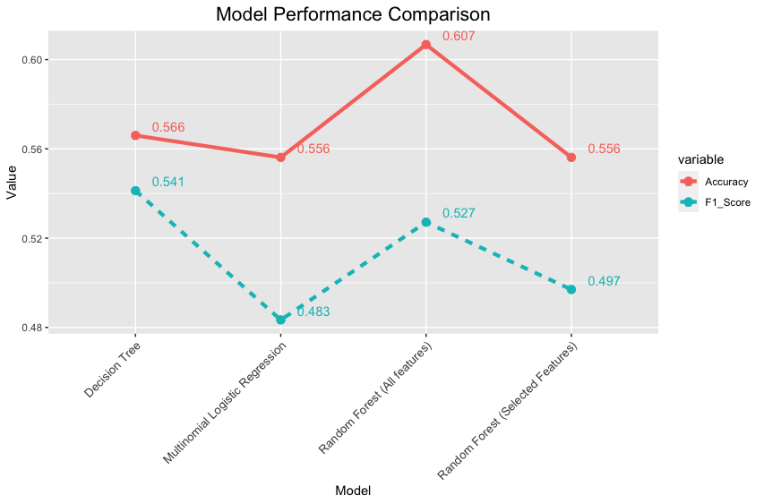
Model Comparison
The Random Forest model using all features yielded the highest accuracy and
F1 score among the models examined.

Slide 30
Observations & Findings
Target variable: Communication channel
Below features have been deemed as the most important for predicting the target variable Source ( Communication channel ) based on their respective coefficients obtained from our Lasso model.
'I agree that I may be video recorded and acknowledge that I am aware that the recording will be available to the public._Yes' (categorical feature)
'Season' (numerical feature)
'Field_3D Printing in Hospitals' (categorical feature)
'Attended_No' (categorical feature)
'Attended_Yes' (categorical feature)
Multinomial Logistic Regression Model:
The multinomial logistic regression model achieved an accuracy of 56% and an F1 score of 0.48.
The accuracy and F1 score were similar to the Lasso model, indicating comparable performance.
Random Forest Model (Selected Features):
The random forest model with selected features achieved an accuracy of 56% and an F1 score of 0.50.
The accuracy and F1 score were similar to the Lasso and logistic regression models.

Slide 31
Observations & Findings
Random Forest Model (All Features):
The random forest model with all features achieved a slightly higher accuracy of 61% and an F1 score of 0.53.
Including all features improved the model's performance compared to using selected features only.
Decision Tree Model:
The decision tree model achieved an accuracy of 57% and an F1 score of 0.54.
The cross-validation accuracy scores were consistent, ranging from 0.568 to 0.592.
Overall,the random forest model using all features yielded the highest accuracy and F1 score among the models examined.

Slide 32
Recommendations
Utilize Random Forest with All Features: The random forest model using all features showed the highest accuracy and F1 score among the models tested. Therefore, it is recommended to utilize this model for predicting the target variable or making decisions based on the given dataset.
Explore Feature Importance: Pay attention to the selected features identified by the Lasso regularization model. These features have shown to be influential in predicting the target variable. Investigate their significance and potential impact on the business goals and outcomes.
Further Model Evaluation and Improvement: Continuously evaluate and refine the models by experimenting with different algorithms, hyperparameters, and feature engineering techniques. This can help improve the model's performance and provide more accurate predictions.
Domain-Specific Considerations: Take into account any specific domain or Industry or Field knowledge or insights that could further enhance the model's accuracy and predictive power.

Slide 33
Further Research
The new innovation of products, technology, and solutions in 3D printing industry
How to educate and advances the uses and applications of new technologies?
Does our current educational trainings, workshop and seminars meet the demand of current target audience?
The event topic and speakers will attract the target audience?
How to improve target audience engagement in the event?
How to work with 3D printing community members to celebrate the diversity throughout community and industry?
The hyperparameter tuning methods to optimize the performance of our classification models. Methods such as grid search, random search, and Bayesian optimization.
Explore ensemble methods like bagging, boosting to improve the model performance for prediction.

Slide 34
References
Grossmann, G. (2021). Medical 3D printing market size, share & trends analysis report by product (equipment, materials, services), by technology (EBM, SLS, SLA, DMLS, PolyJet), by application, by end use, and segment forecasts, 2020-2027. Grand View Research. https://www.grandviewresearch.com/industry-analysis/medical-d-printing-market
Morrison, C. (2021). The medical applications for 3D printing. AZoM. https://www.azom.com/article.aspx?ArticleID=17405
Scully, A. (2019). The business of 3D printing in healthcare: How to create and capture value. Deloitte Insights. https://www2.deloitte.com/us/en/insights/industry/health-care/business-of-3d-printing-in-health-care.html
Tofte, M. W., Jensen, T. S., & Pedersen, D. B. (2018). 3D printing in healthcare: A SWOT analysis. Procedia CIRP, 71, 306-311. https://doi.org/10.1016/j.procir.2018.05.051

Slide 35


